Slide 1

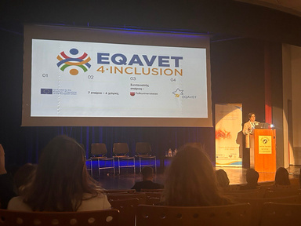
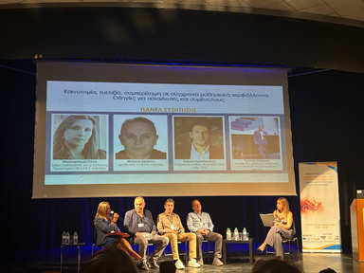
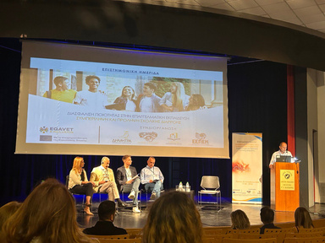

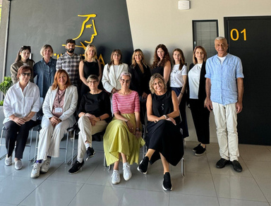


SIXTH NEWSLETTER | NOVEMBER 2024
NEWSLETTER | JUNE 2022
As the Eqavet4Inclusion project wraps up, we reflect on our enriching final conference in Larissa and share streamlined policy recommendations to continue our work on preventing dropouts and fostering inclusion in VET.
Celebrating Our Final Events
Our final conference, held on October 3, 2024, in Larissa, Greece, was a pinnacle of shared knowledge and commitment. Educators, policymakers, and experts gathered to enhance "Quality Assurance in Vocational Education: Inclusion and Prevention of Dropout," engaging in rich dialogues that will shape future educational practices.
Event Highlights:
  We explored critical topics like Digital Accessibility, Teacher Training Needs, and Inclusion Pathways, offering deep insights into modernizing vocational education.
  We showcased our model, which has set a benchmark for integrating quality assurance with inclusion strategies.
Final Meeting Overview
Post-conference, our consortium reviewed all deliverables and discussed the project's long-term impact, celebrating our collective achievements.
The European Commission's support for the production of this publication does not constitute an endorsement of the contents, which reflect the views only of the authors, and the Commission cannot be held responsible for any use which may be made of the information contained therein.

Slide 2







SIXTH NEWSLETTER | NOVEMBER 2024
NEWSLETTER | JUNE 2022
Policy Recommendation
Based on our findings, we propose:
  Support the integration of inclusive technologies.
  Boost training in inclusion and dropout prevention.
  Tailor vocational education to diverse student needs.
  Our policy initiatives strive to adapt these strategies across national educational frameworks, securing their sustainability and enhancing their impact throughout Europe.
  Thank you for your dedication and support. We are excited to see the lasting changes our project will inspire in vocational education.
  FB EQAVET4INCLUSION LinkedIn EQAVET4INCLUSION
  https://eqavet4inclusion.eu/
  EQAVET Partners
The European Commission's support for the production of this publication does not constitute an endorsement of the contents, which reflect the views only of the authors, and the Commission cannot be held responsible for any use which may be made of the information contained therein.

